Slide 1

Climate Variability and Change Impact on Crop Yield
Presented by:
Rajul Upadhyay
(21AG62R10)
Under the guidance of
Prof. Ashok Mishra
LAND AND WATER RESOURCES ENGINEERING
AGRICULTURAL AND FOOD ENGINEERING DEPARTMENT
INDIAN INSTITUTE OF TECHNOLOGY KHARAGPUR

Slide 2
Contents of Presentation
2
Introduction
Review of literature
Research Gap
Objectives
Study Area
Material and Methods
Results
Conclusion

Slide 3
Introduction
Global climate variability and change caused by natural processes and anthropogenic factors are major and important environmental issues that will affect the world.
In AR6, IPCC has reported a likely global temperature increase in the range:
1.4°C for low emissions scenario (SSP1-1.9),
2.7°C for an intermediate emissions scenario (SSP2-4.5) , and
4.4°C for a very high emissions scenario (SSP5-8.5).
The global surface temperature has risen faster than in any prior 50-year period in at least the last 2,000 years.

Slide 4
Introduction
Climate change will increasingly add pressure on food production systems, undermining food security. Exposure to climate hazards will grow substantially, further stressing food security.
India accounts for about 12.5% of the total global wheat production and stands second after China.
The crop yield is dependent on factors like water availability, temperature, atmospheric CO₂ concentration which are directly affected by climate change.

Slide 5
Review of literature
Year | Authors | Title | Findings
2011 | Kumar et al. | Impact of climate change on crop productivity in Western Ghats, coastal and northeastern regions of India | Irrigated rice in the Western Ghats region is likely to change by +5% to -11% in the PRECIS Alb 2030 scenario. Climate change in the 2030 scenario is projected to affect the yields of irrigated rice up to 10% in majority of the coastal district.
2013 | Mishra et al. | Spatial variability of climate change impacts on yield of rice and wheat in the Indian Ganga Basin | In the upper IGB the rice yield will vary from −5.9 to −43.2% as compared to +1.2 to −22.6% in the lower IGB. Similarly, the wheat yield will vary from −6.1 to −20.9% in the upper IGB as compared to 5.4 to −1.7% in the lower IGB.

Slide 6
Review of literature
Year | Authors | Title | Findings
2018 | Kang et al. | A watershed-scale assessment of climate change impacts on crop yields in Atlantic Canada | Overall, results indicate crop yield reduction during rest of the 21st century due to climate change. Results suggest that although elevated CO₂ concentrations could potentially increase crop yields, a projected increase in water stress caused by rising temperatures would offset this CO₂ fertilization effect, leading to an overall decrease in crop yields.
2022 | Arunrat et al. | Climate change impact on major crop yield and water footprint under CMIP6 climate projections in repeated drought and flood areas in Thailand | The precipitation and maximum and minimum temperatures were projected to increase in all periods under both scenarios. There was a predicted reduction of first and second rice crop yields by −6.0% to −17.7% The total WFs of maize, soybean, mung bean, and cassava production were roughly half that of rice production, indicating that these crops are suitable alternatives in the dry season.

Slide 7
Review of literature
Year | Authors | Title | Findings
2022 | Lontsi Saadio et al. | Crops yield prediction based on machine learning models: Case of West African countries | Decision tree model performs well with a coefficient of determination(𝑅²) of 95.3% while the K-Nearest Neighbor model and logistic regression perform, respectively, with 𝑅² of 93.15% and 89.78%. The prediction results of the decision tree model and the K-Nearest Neighbor model are correlated to the expected data, which proves the efficacy of the model.

Slide 8
Research Gaps
The earlier performed studies are mostly at India level or zone wise. However, no study has analysed yield on district level in Chhattisgarh.
Also, none of the studies has been conducted using CMIP6 projections in India, let alone Chhattisgarh.

Slide 9
Objectives
To setup, calibrate and validate the APSIM Next Generation and DSSAT model for simulating district wheat yields for Chhattisgarh.
To evaluate the impacts of climate change on wheat yield under CMIP6 climatic projections.

Slide 10
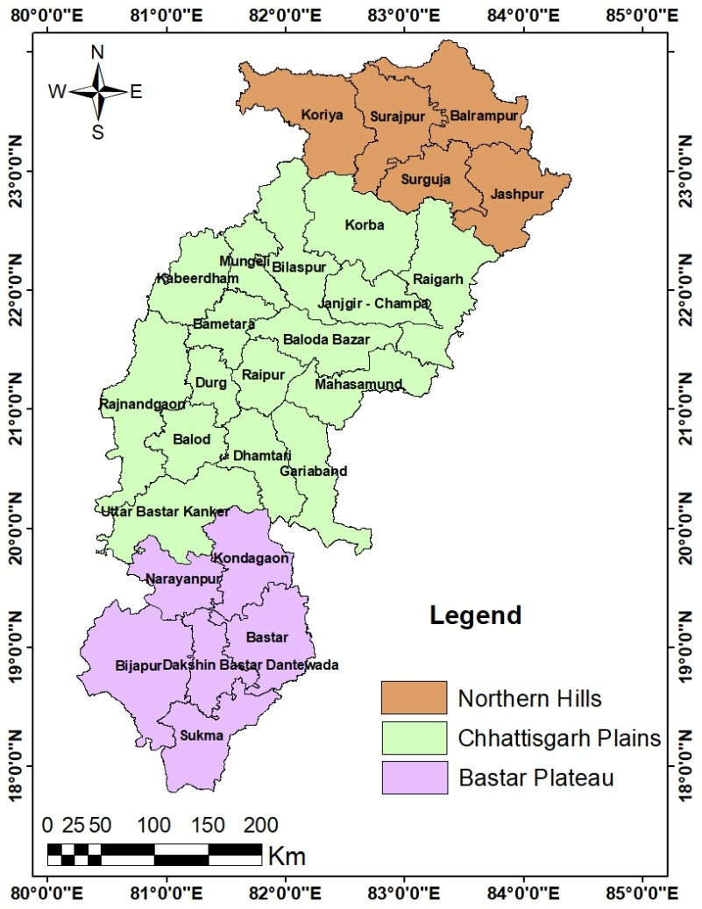
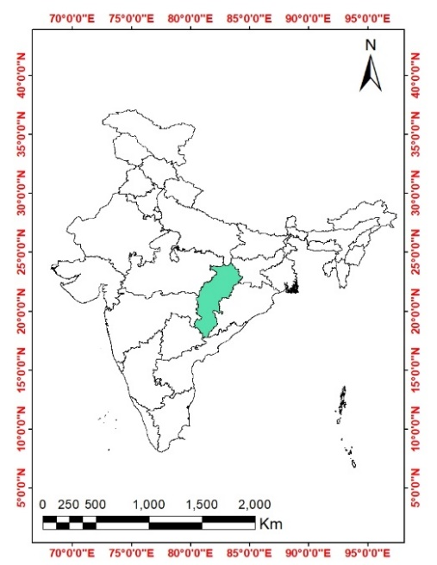
Study Area
10th largest state in India.
Average Annual Rainfall - 1207 mm.
Average annual maximum temperature - 32.29 °C.
Average annual minimum temperature - 20.04 °C.

Slide 11




Data and Source
Data Type | Source | Data Description
Hydro-met. Data | India Meteorological Department (IMD) | Daily rainfall, maximum and minimum temperature for the period 1981 to 2020 at 0.25º x 0.25º resolution
Soil data | Food and Agriculture Organisation (FAO) | Soil types for districts of Chhattisgarh
Hydro-met. Data | RadEst3 Model | Simulated Solar Radiation, point wise using maximum and minimum temperature and rainfall
Hydro-met. Data | Earth System Grid Federation (ESGF) | Simulated Daily rainfall, maximum and minimum temperature for year 2015 to 2100 at 0.7º x 0.7º resolution for GCM EC-Earth3

Slide 12
Similarities between APSIM Next Gen and DSSAT
Simulate the growth and development of crops under different environmental conditions.
Similar approach for modeling crop growth and development, which involves simulating the processes of photosynthesis, respiration, transpiration, nutrient uptake, and partitioning of biomass.
Similar requirements for input data, such as weather data, soil data, and management practices.
The models works on daily time steps and can simulate crop yields for hundreds of years.

Slide 13
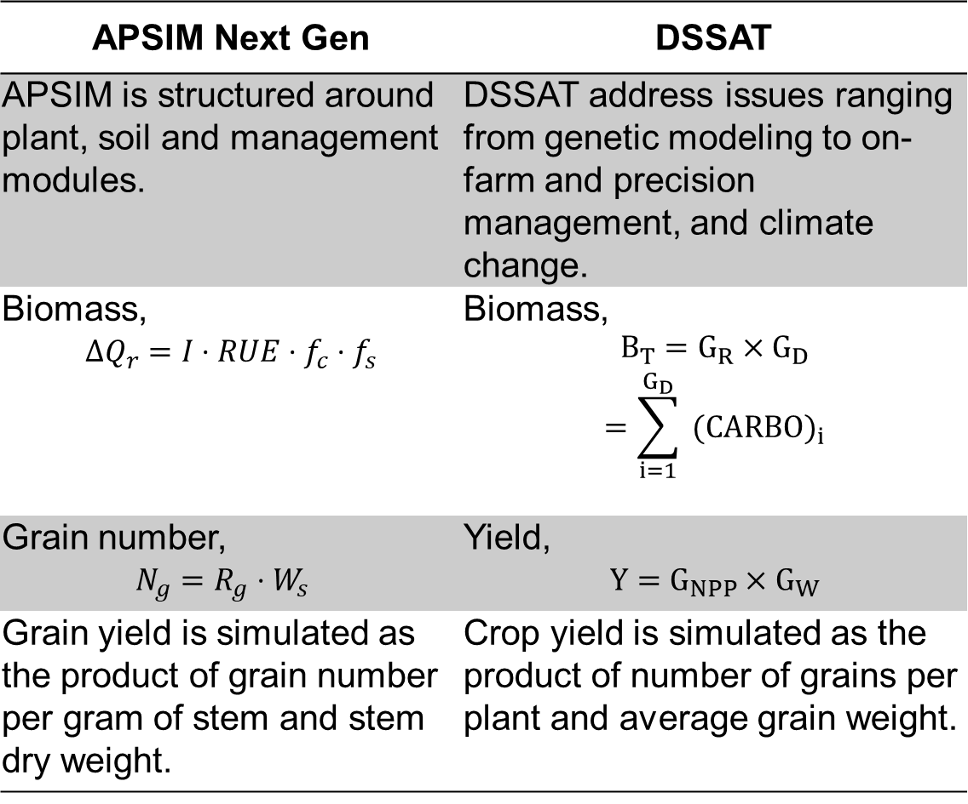
Differences between APSIM Next Gen and DSSAT
APSIM Next Gen | DSSAT
APSIM is structured around plant, soil and management modules. | DSSAT address issues ranging from genetic modeling to on-farm and precision management, and climate change.
Biomass, $$ΔQ_{r}=I⋅RUE⋅f_{c}⋅f_{s}$$ | Biomass, $$\begin{aligned}B_{T}=G_{R}×G_{D} \\ =\sum_{i=1}^{G_{D}}{ }(CARBO)_{i}\end{aligned}$$
Grain number, $N_{g}=R_{g}⋅W_{s}$ | Yield, $$Y=G_{NPP}×G_{W}$$
Grain yield is simulated as the product of grain number per gram of stem and stem dry weight. | Crop yield is simulated as the product of number of grains per plant and average grain weight.

Slide 14

Calibration and Validation of APSIM Next Gen and DSSAT
APSIM NG
DSSAT

Slide 15
Site : latitude, longitude, elevation.
Daily Weather : solar radiation, max and min temperature, precipitation.
Monthly Climate
Soil Properties
Inputs required by DSSAT

Slide 16
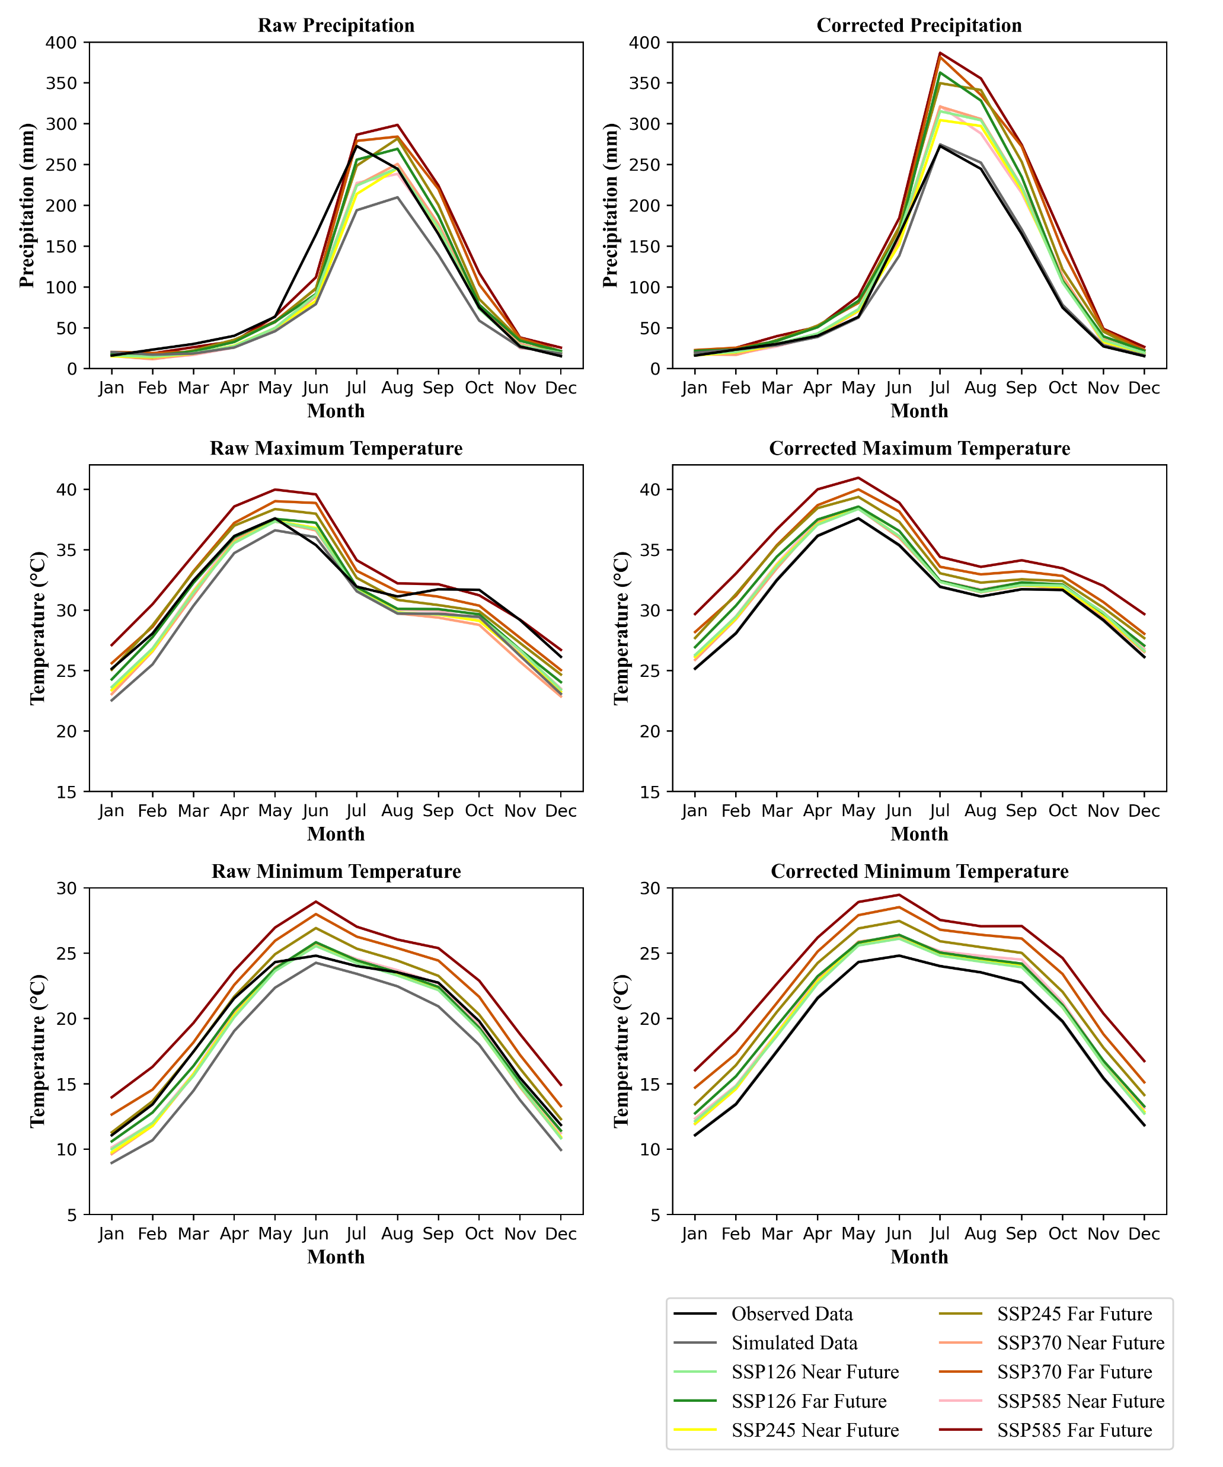
Bias Correction of the Climate Projections
Data |  | Uncorrected | Corrected
Precipitation | R-square | 0.83 | 0.85
 | NSE | 0.59 | 0.66
 | PBIAS | -24.94 | -0.45
Maximum Temperature | R-square | 0.90 | 0.93
 | NSE | 0.50 | 0.77
 | PBIAS | -5.61 | -0.01
Minimum Temperature | R-square | 0.95 | 0.97
 | NSE | 0.64 | 0.81
 | PBIAS | -9.50 | -0.06

Slide 17
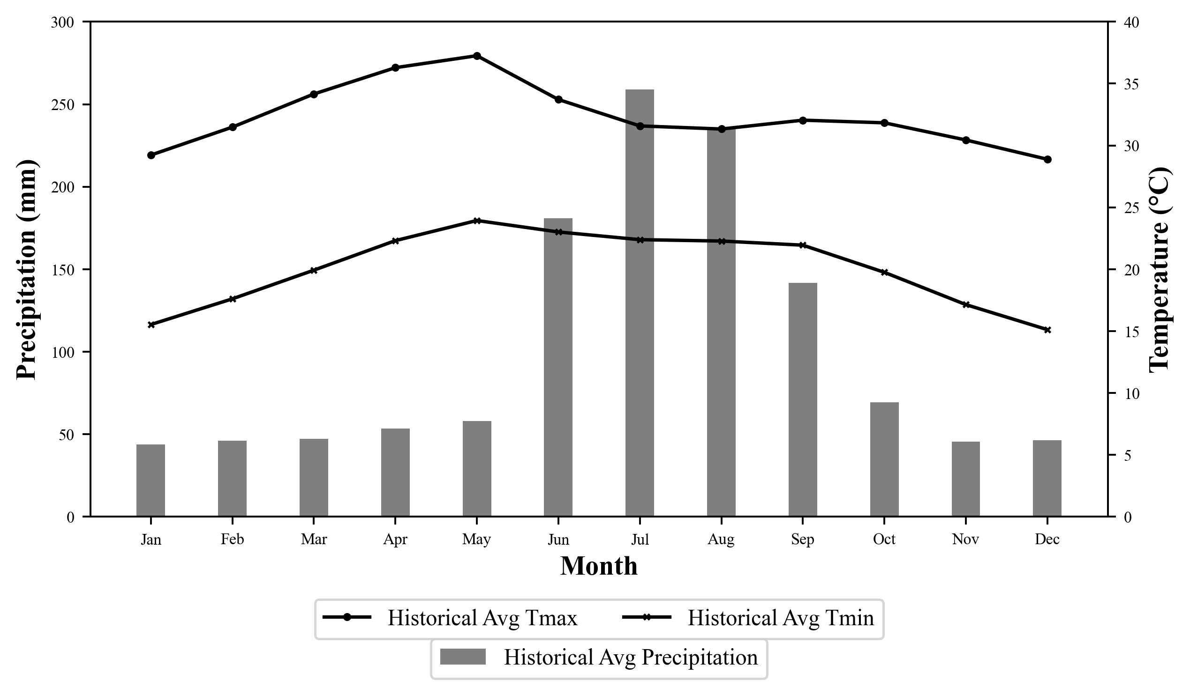
Historical Period : 1981 to 2014

Slide 18
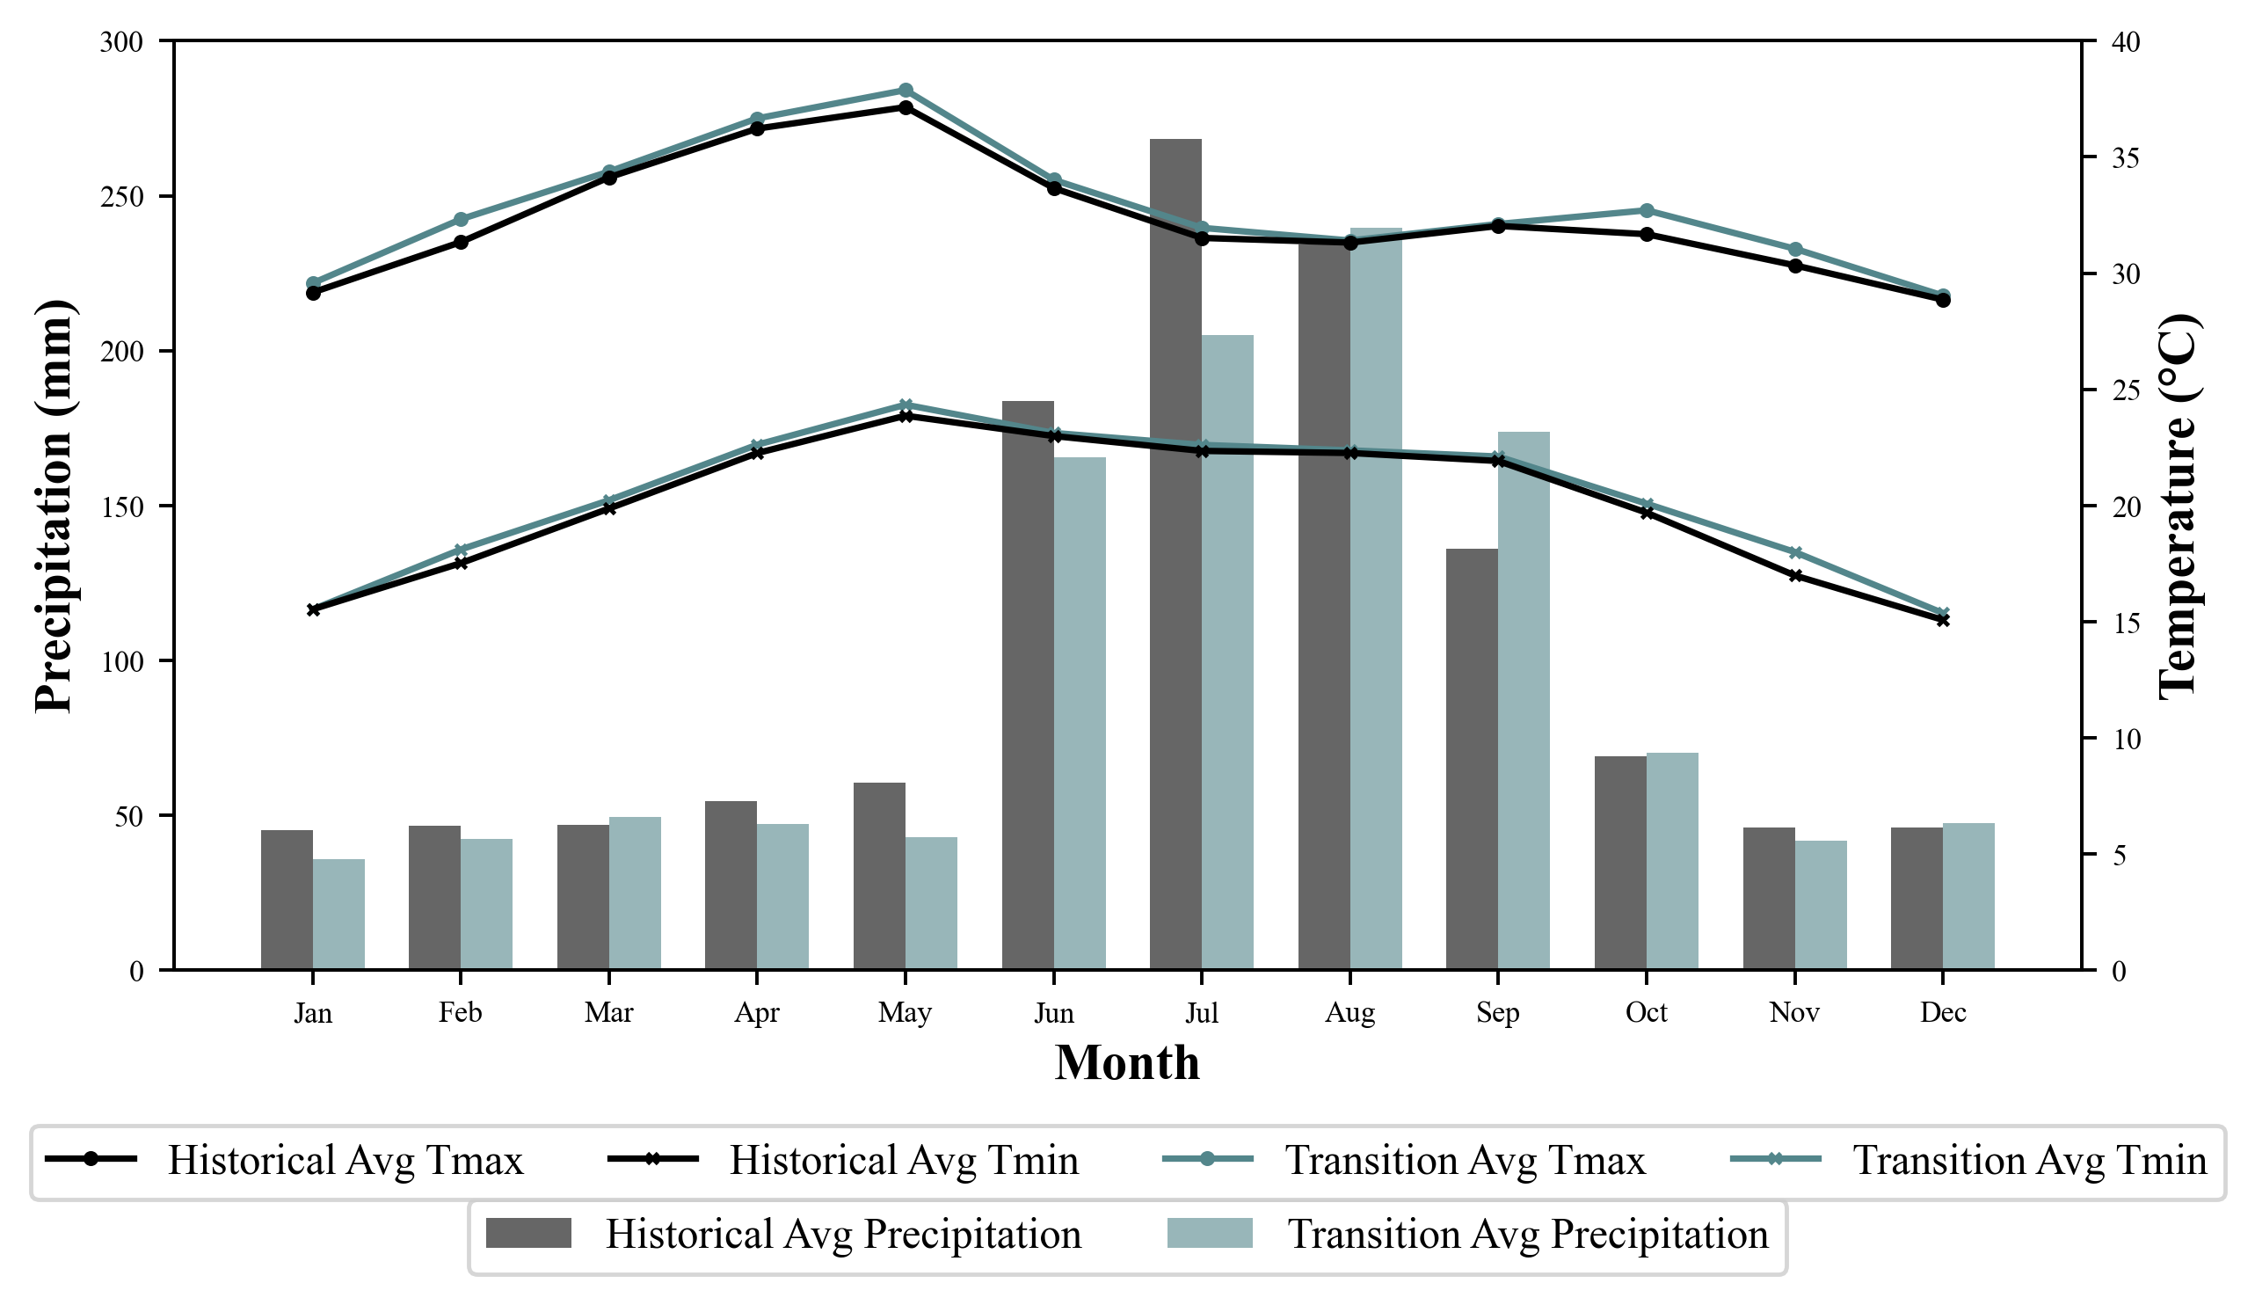
Historical Vs Transition Period : 2015 to 2020

Slide 19
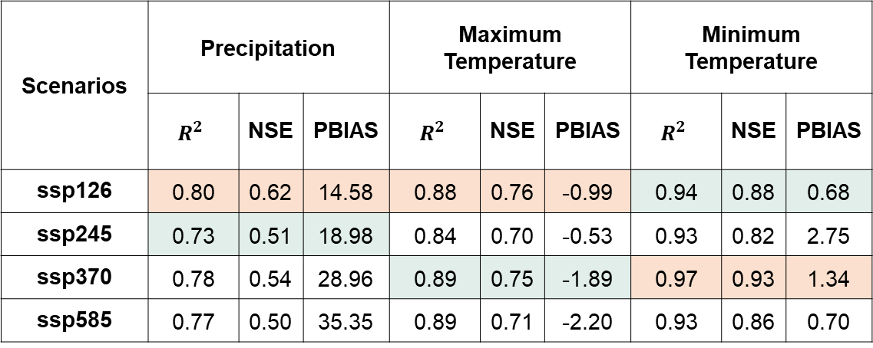
Assessment of Climatic Scenarios for Transition Period
19
Scenarios | Precipitation |  |  | Maximum Temperature |  |  | Minimum Temperature
 | $$R^{2}$$ | NSE | PBIAS | $$R^{2}$$ | NSE | PBIAS | $$R^{2}$$ | NSE | PBIAS
ssp126 | 0.80 | 0.62 | 14.58 | 0.88 | 0.76 | -0.99 | 0.94 | 0.88 | 0.68
ssp245 | 0.73 | 0.51 | 18.98 | 0.84 | 0.70 | -0.53 | 0.93 | 0.82 | 2.75
ssp370 | 0.78 | 0.54 | 28.96 | 0.89 | 0.75 | -1.89 | 0.97 | 0.93 | 1.34
ssp585 | 0.77 | 0.50 | 35.35 | 0.89 | 0.71 | -2.20 | 0.93 | 0.86 | 0.70

Slide 20
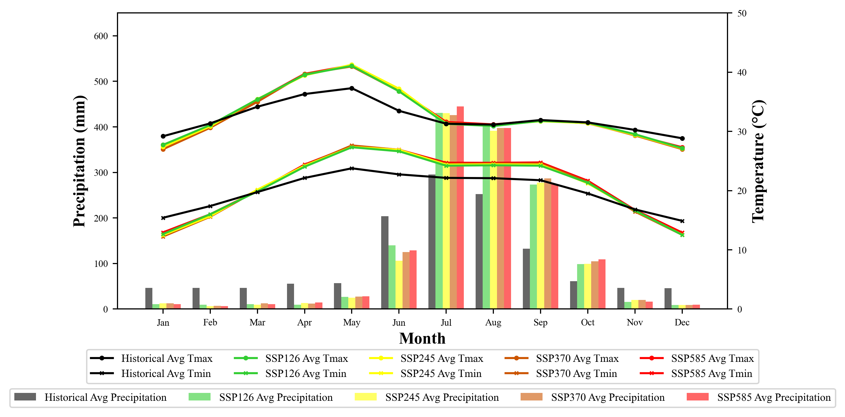
Observed Data vs Simulation for Near Future Period : 2021 to 2060

Slide 21
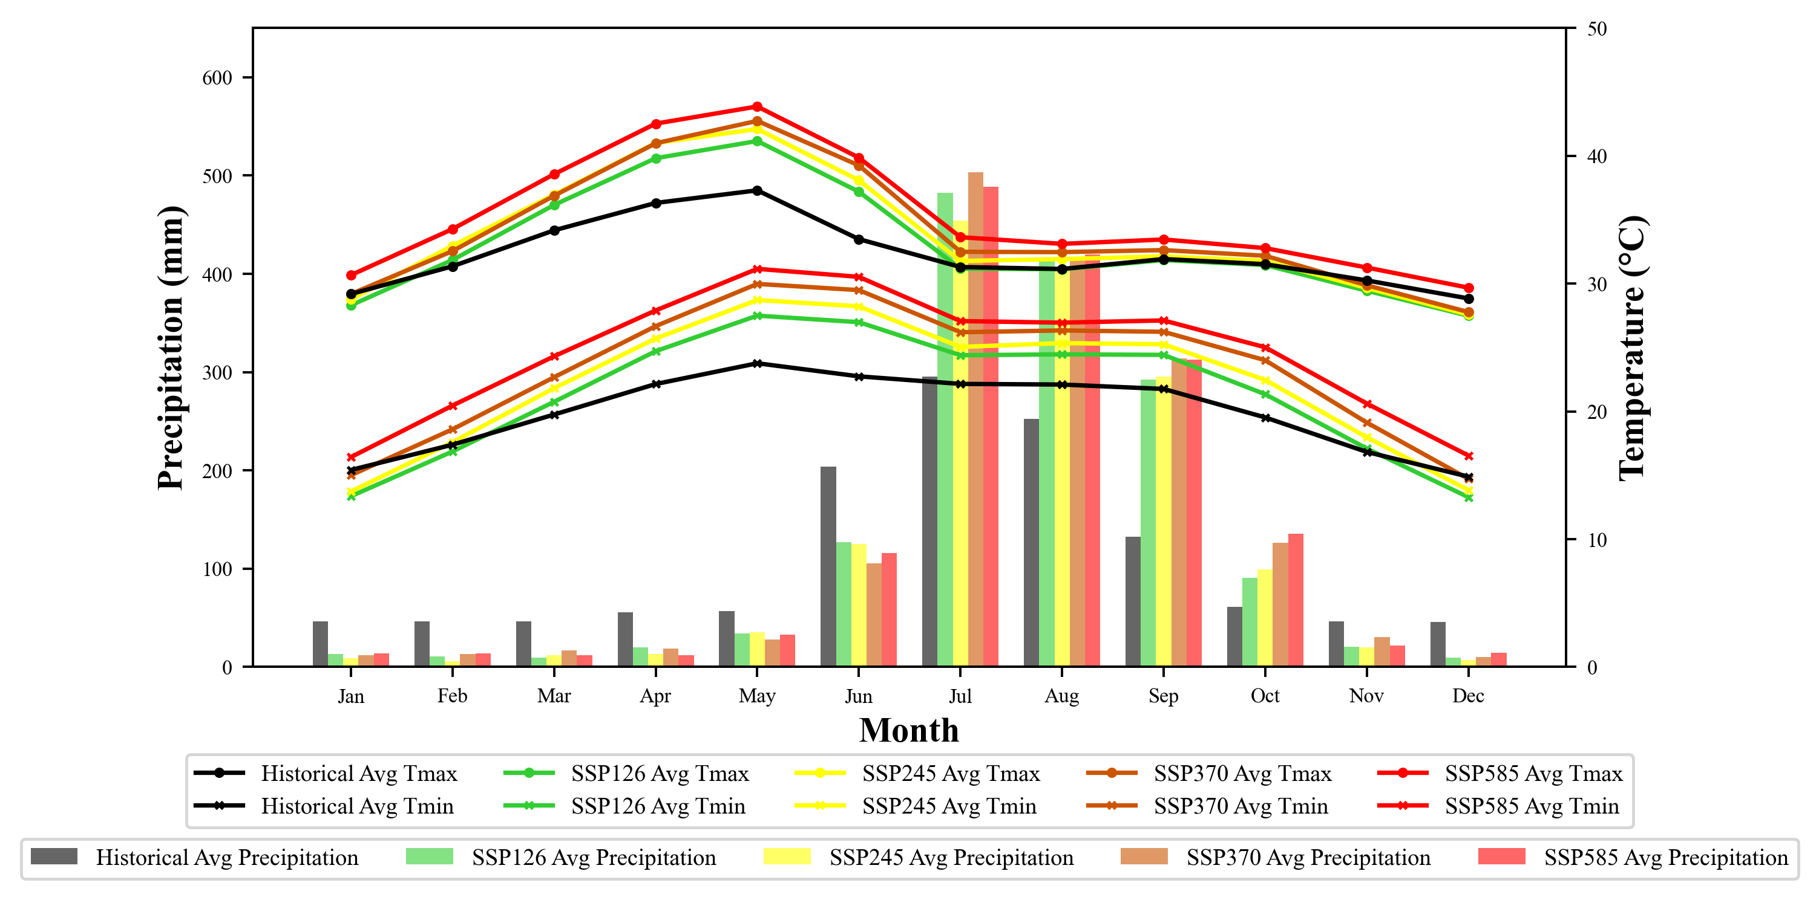
Observed Data vs Simulation for Far Future Period : 2061 to 2100

Slide 22
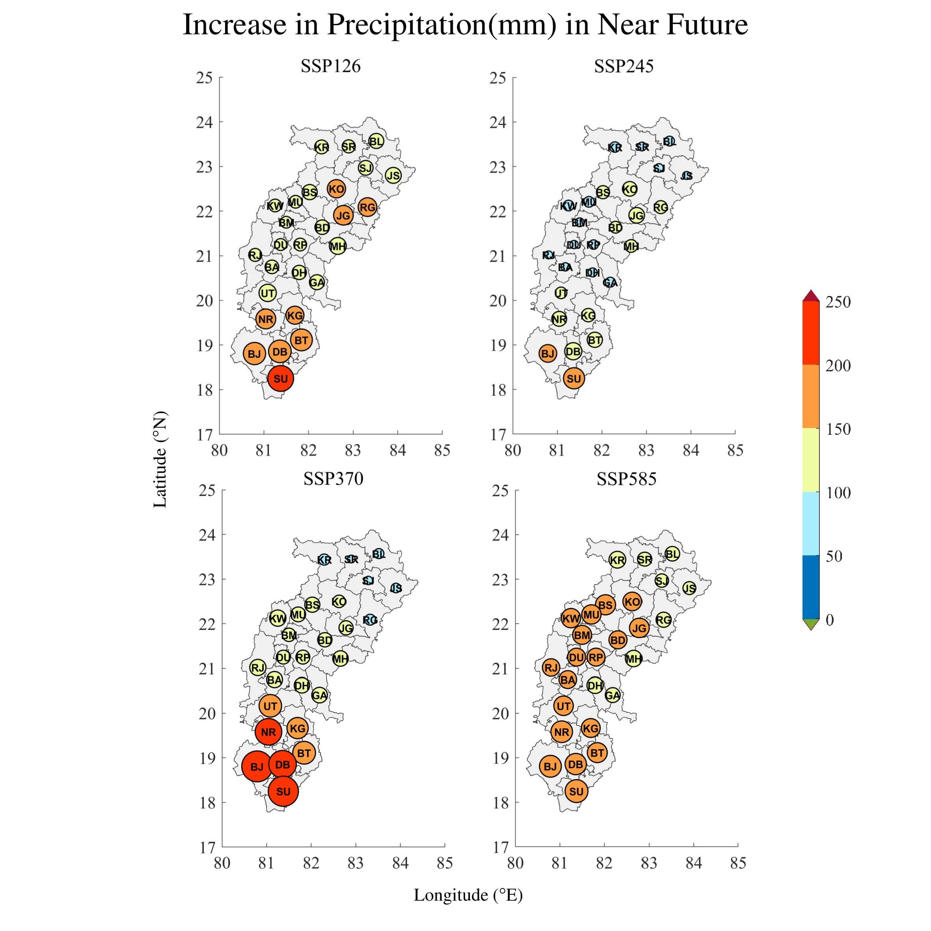
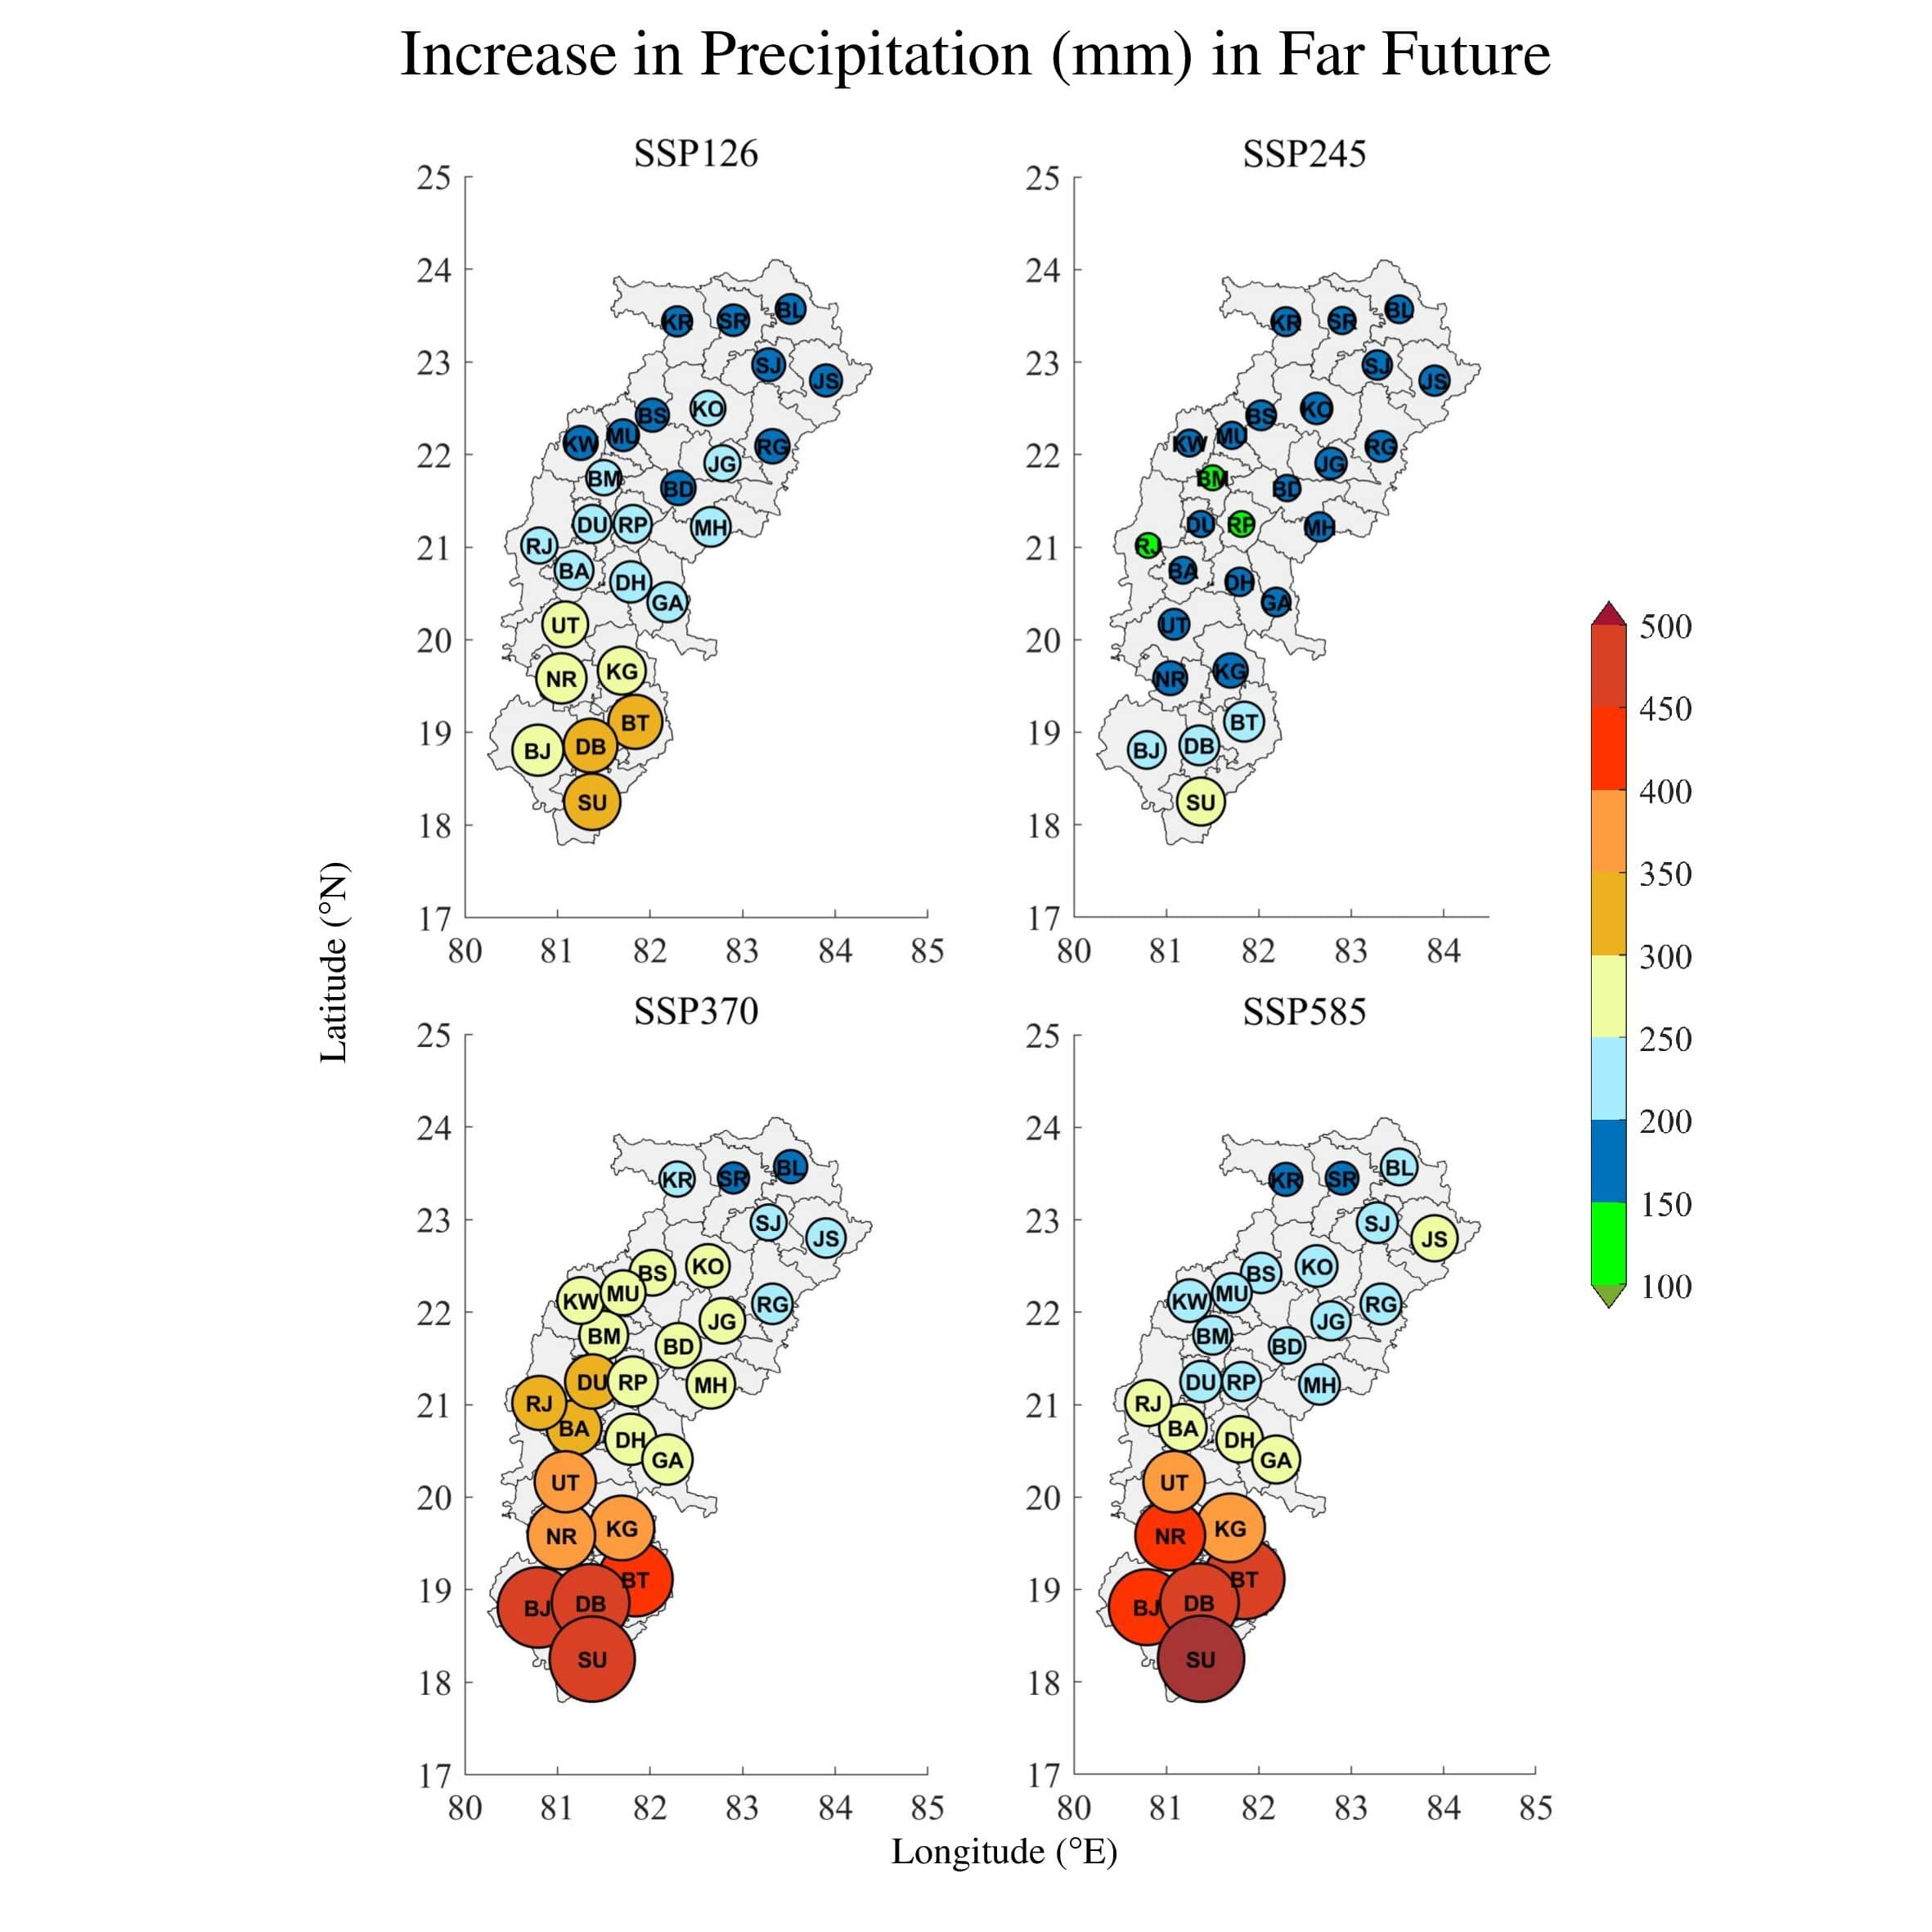
Precipitation Trends During Near Future (2021-2060) and Far Future (2061-2100)

Slide 23
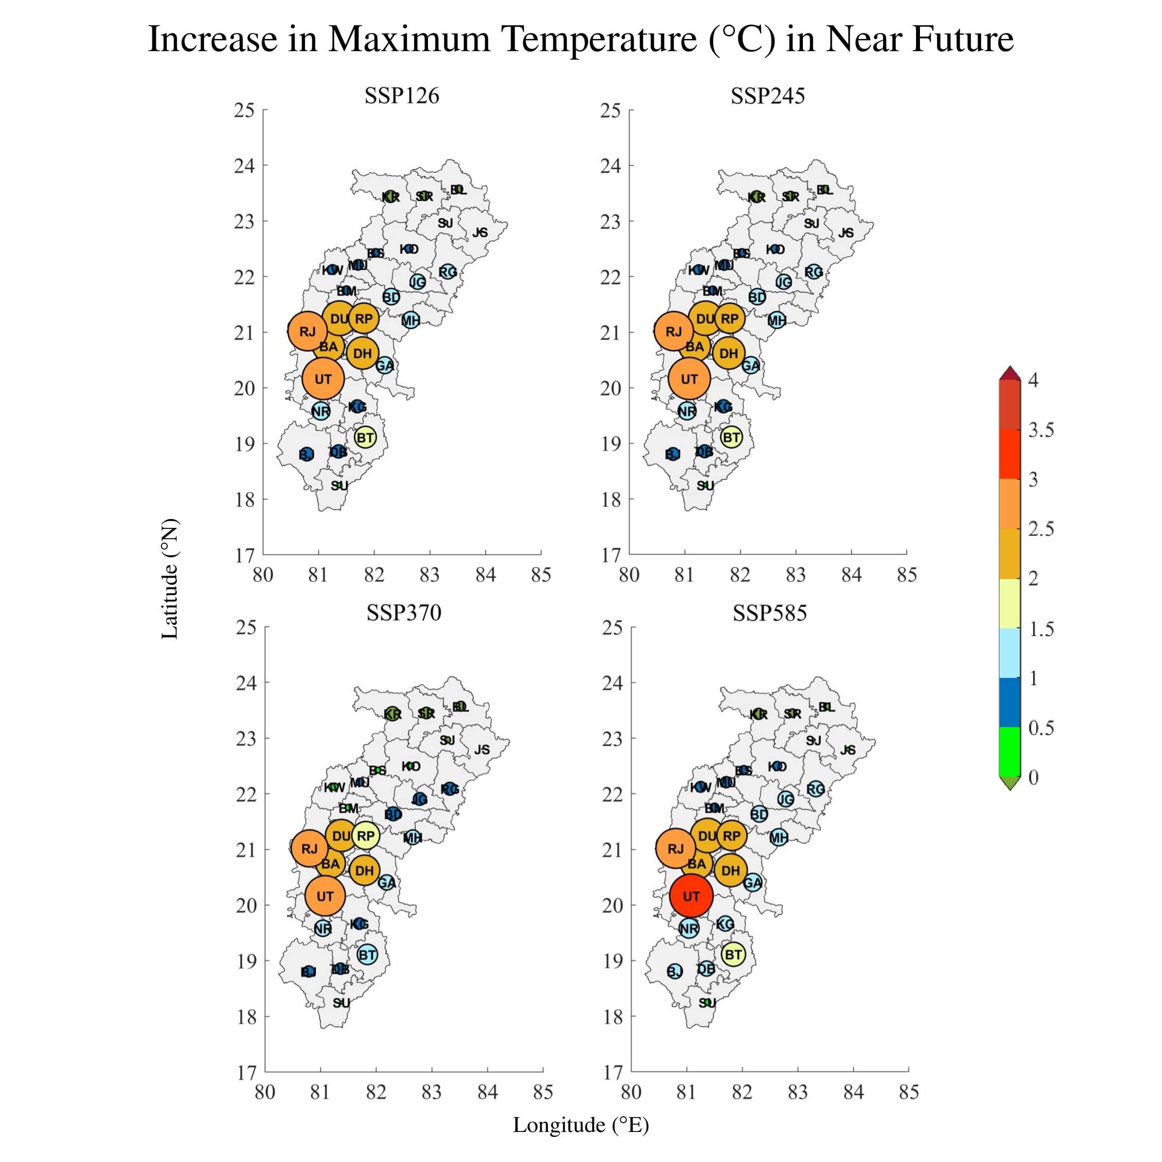
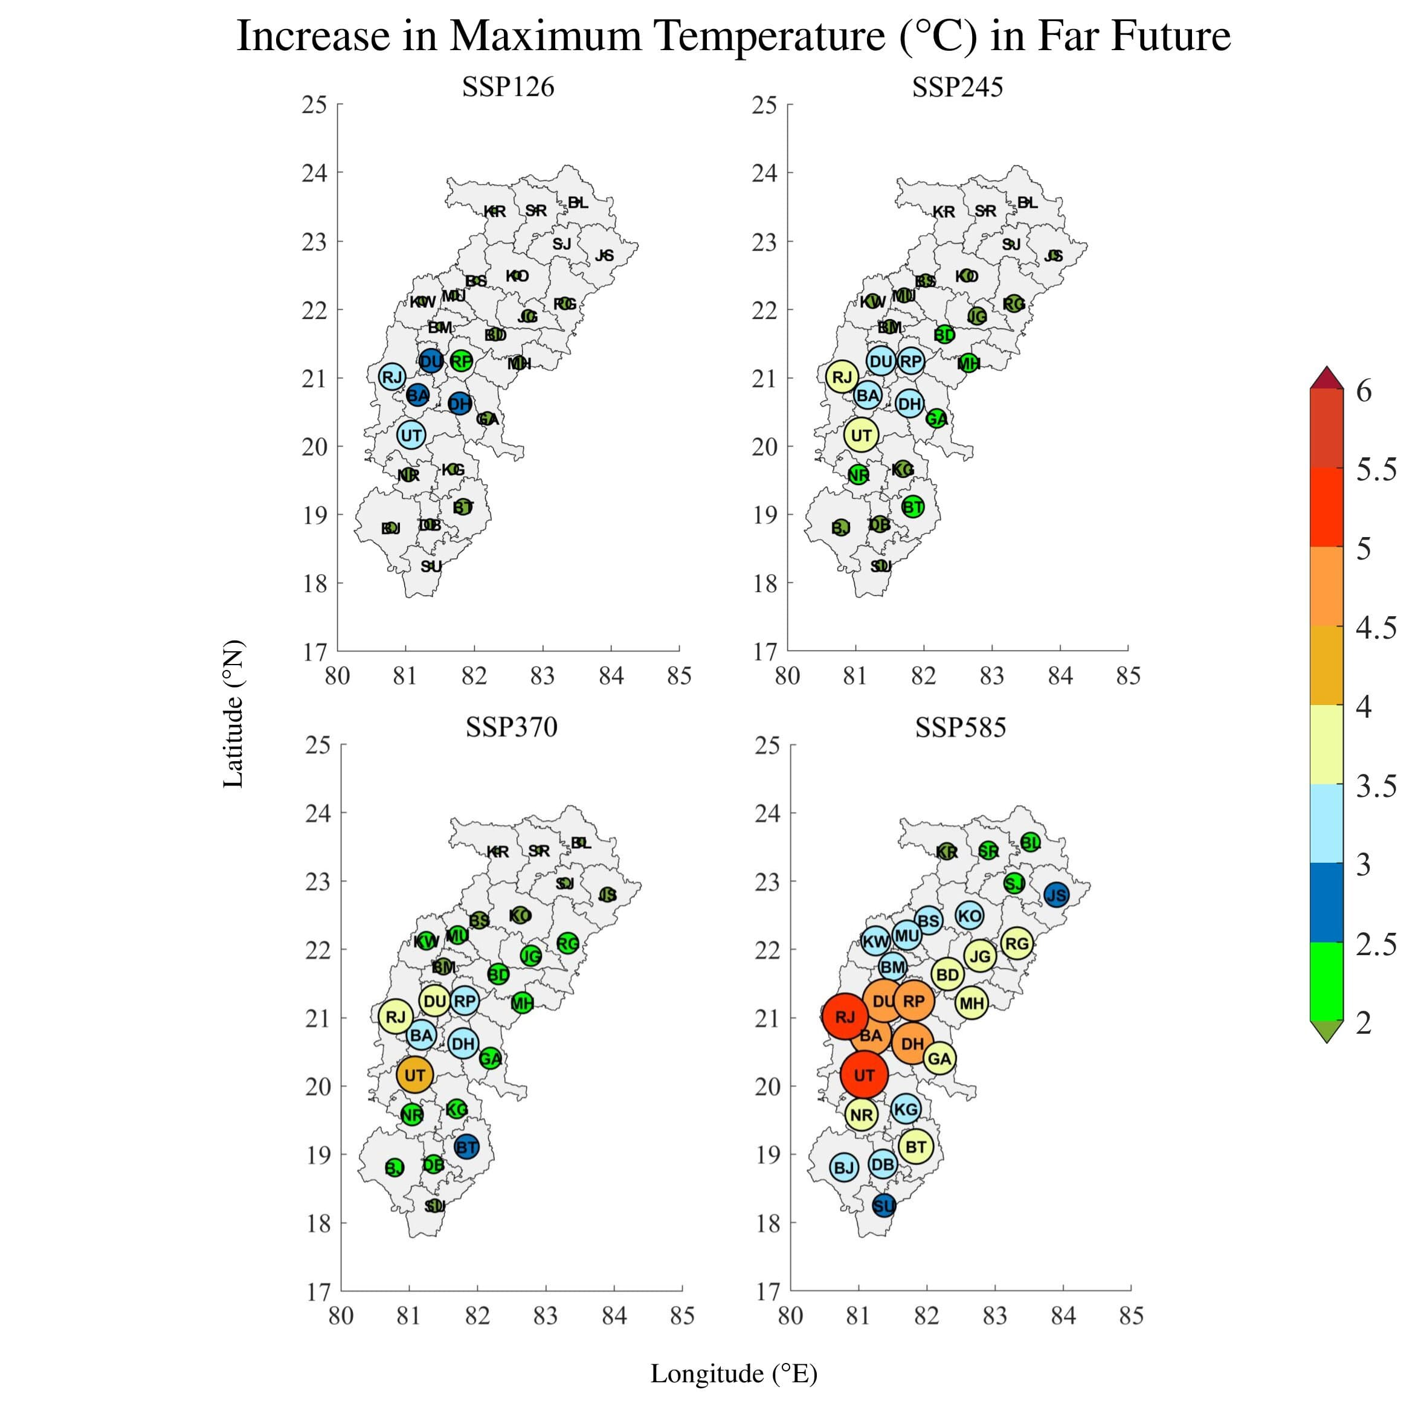
Maximum Temperature Trends During Near Future (2021-2060) and Far Future (2061-2100)

Slide 24
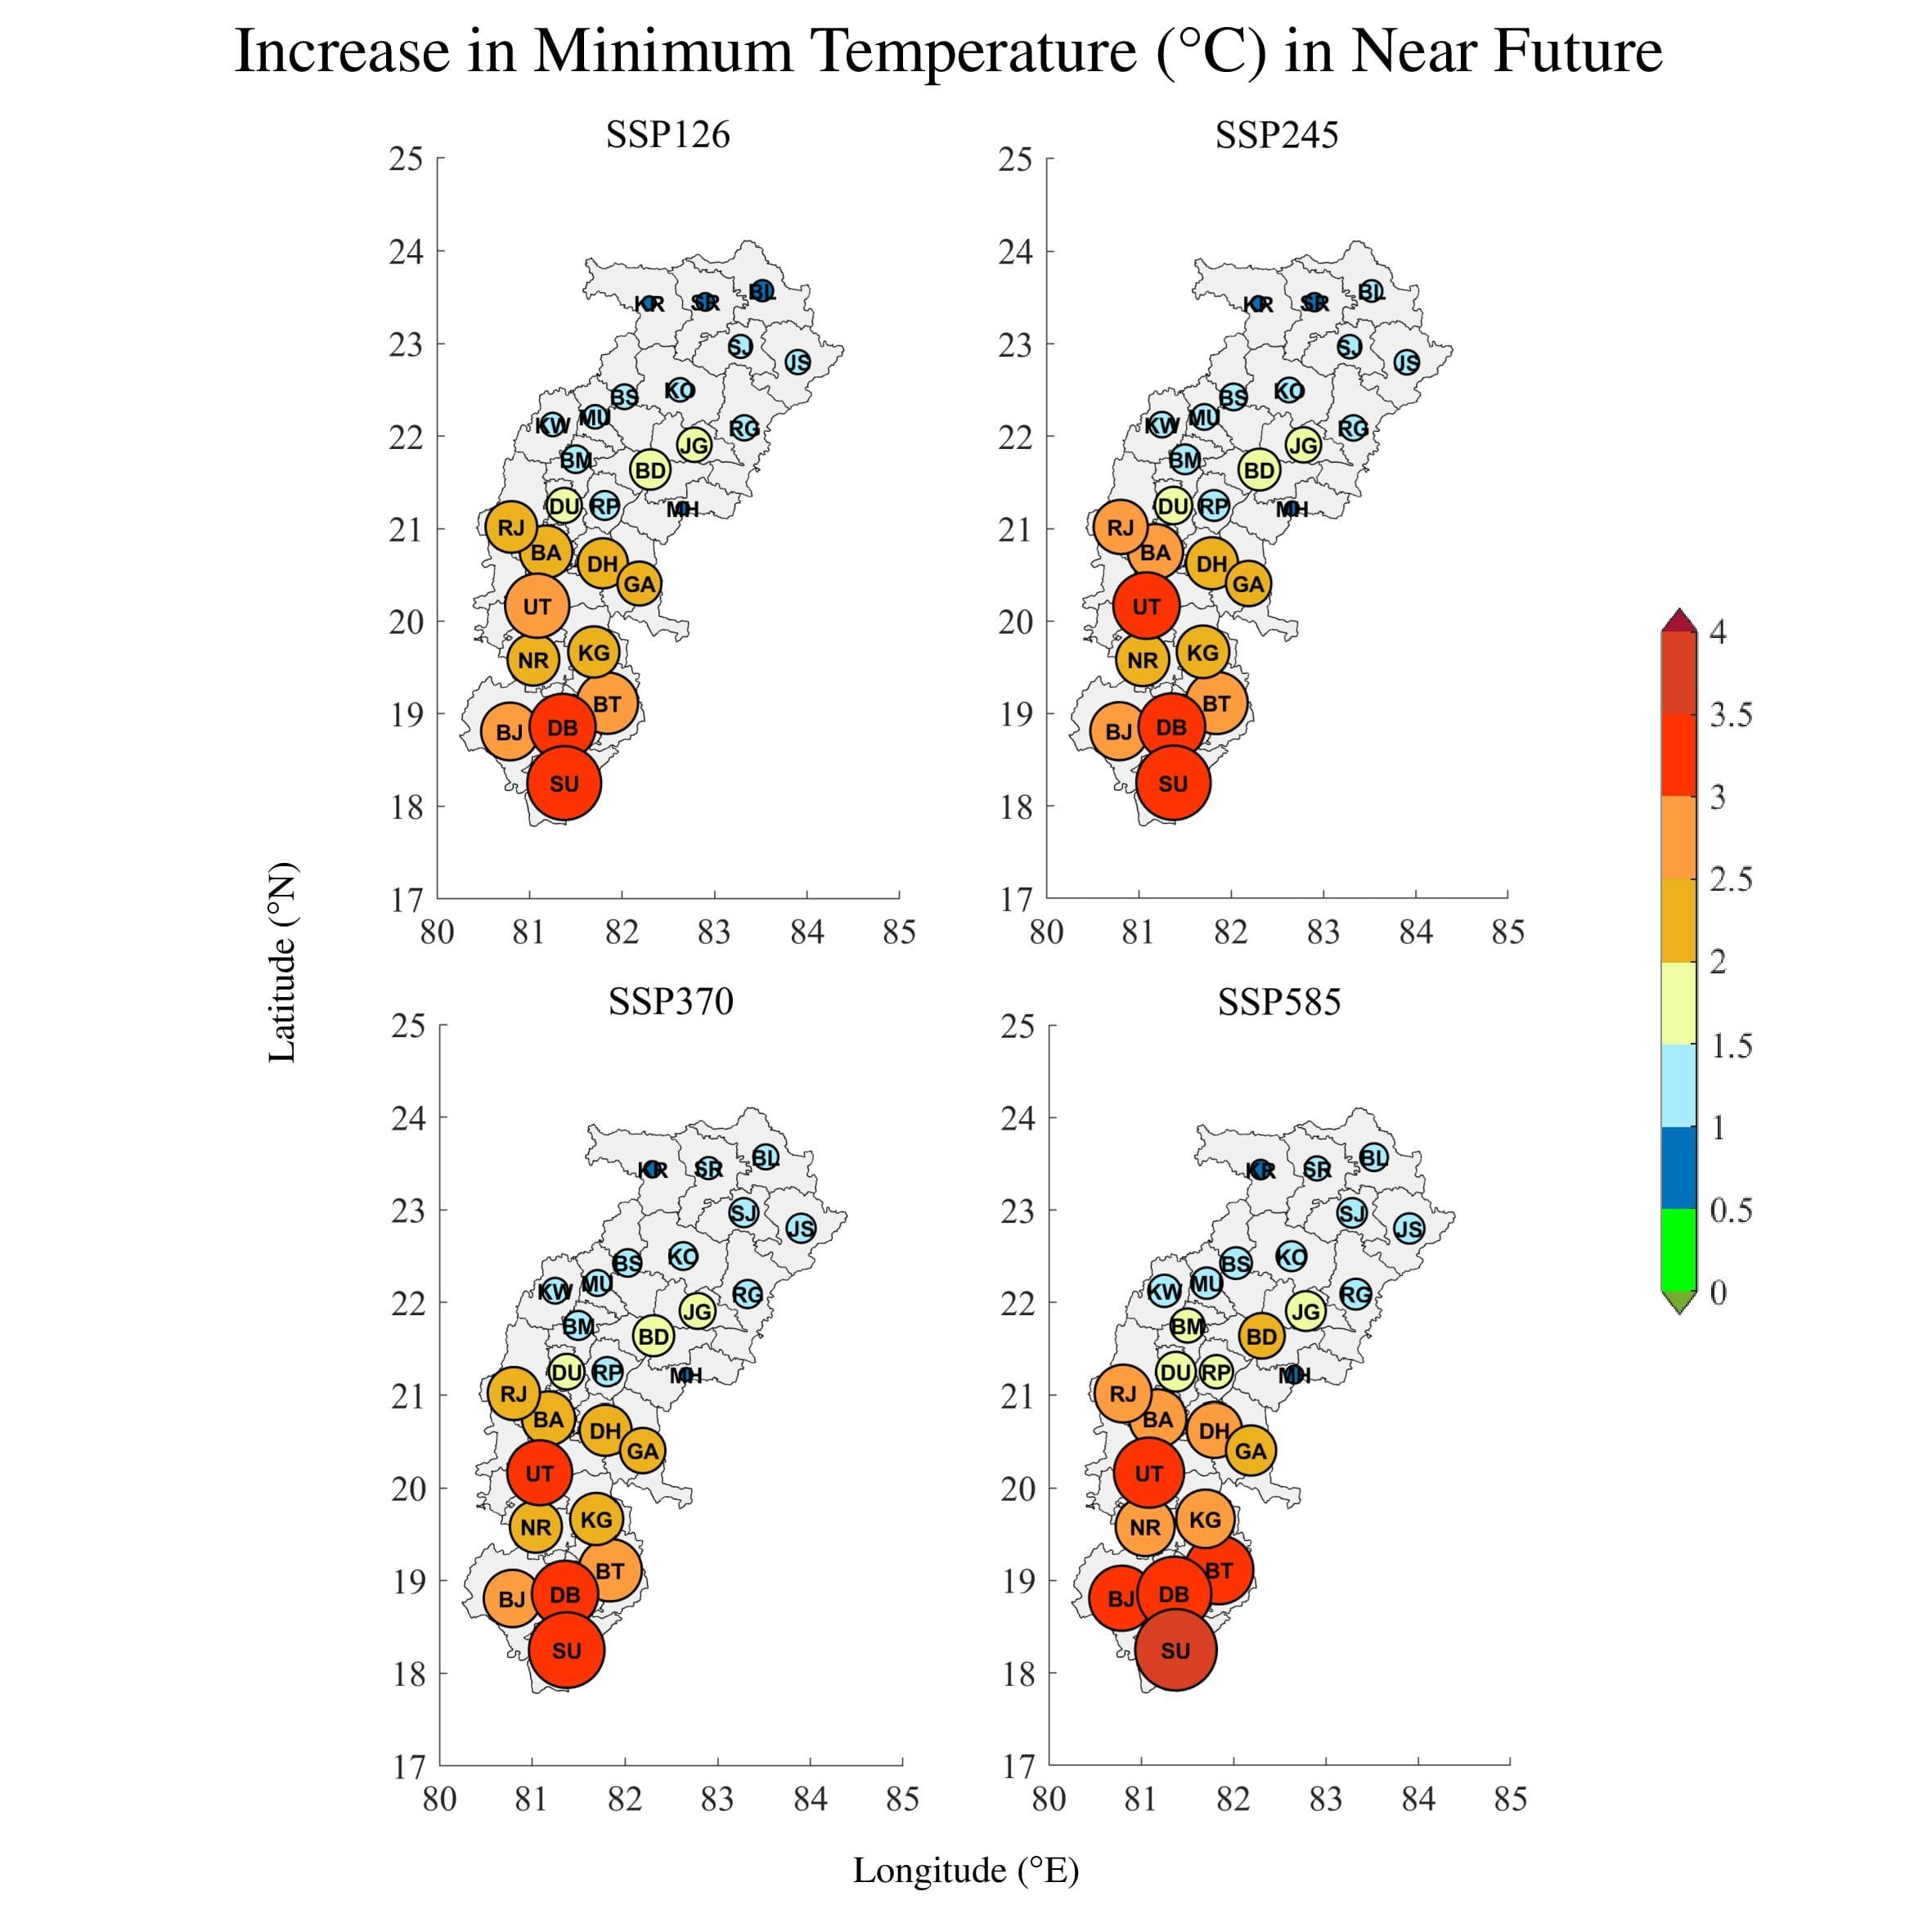
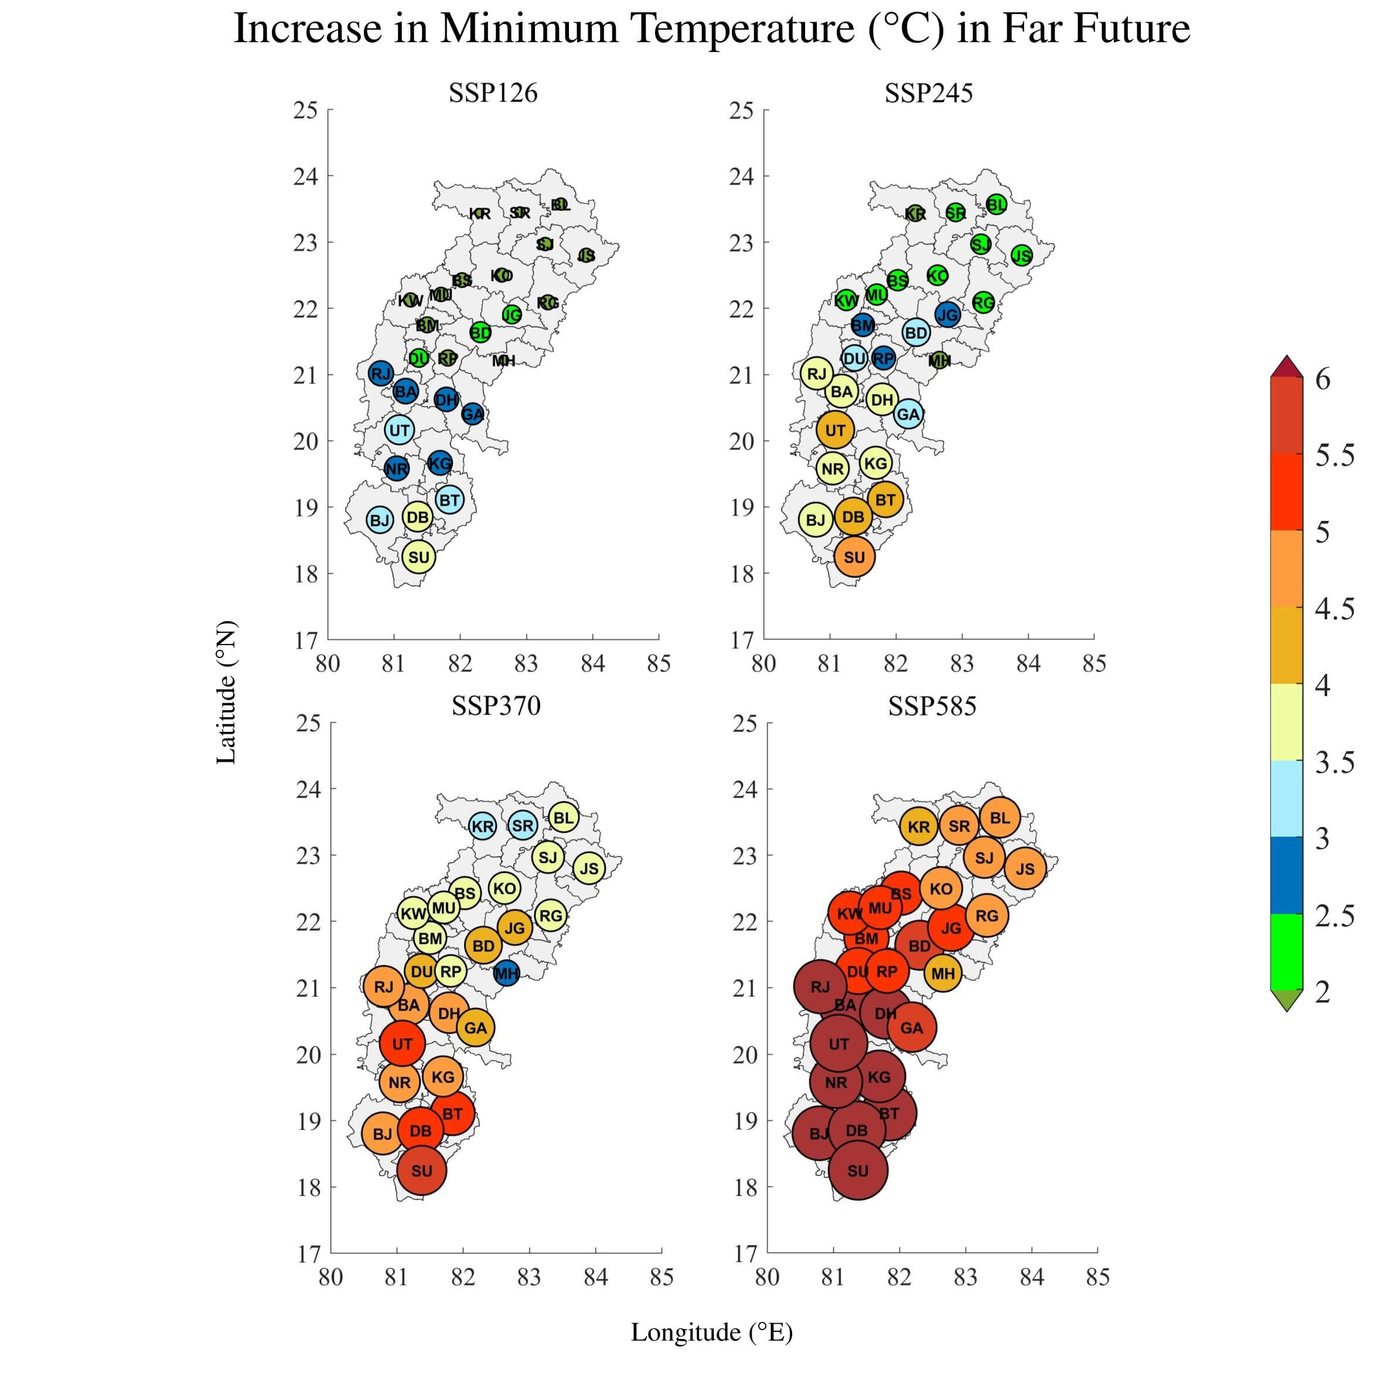
Minimum Temperature Trends During Near Future (2021-2060) and Far Future (2061-2100)

Slide 25
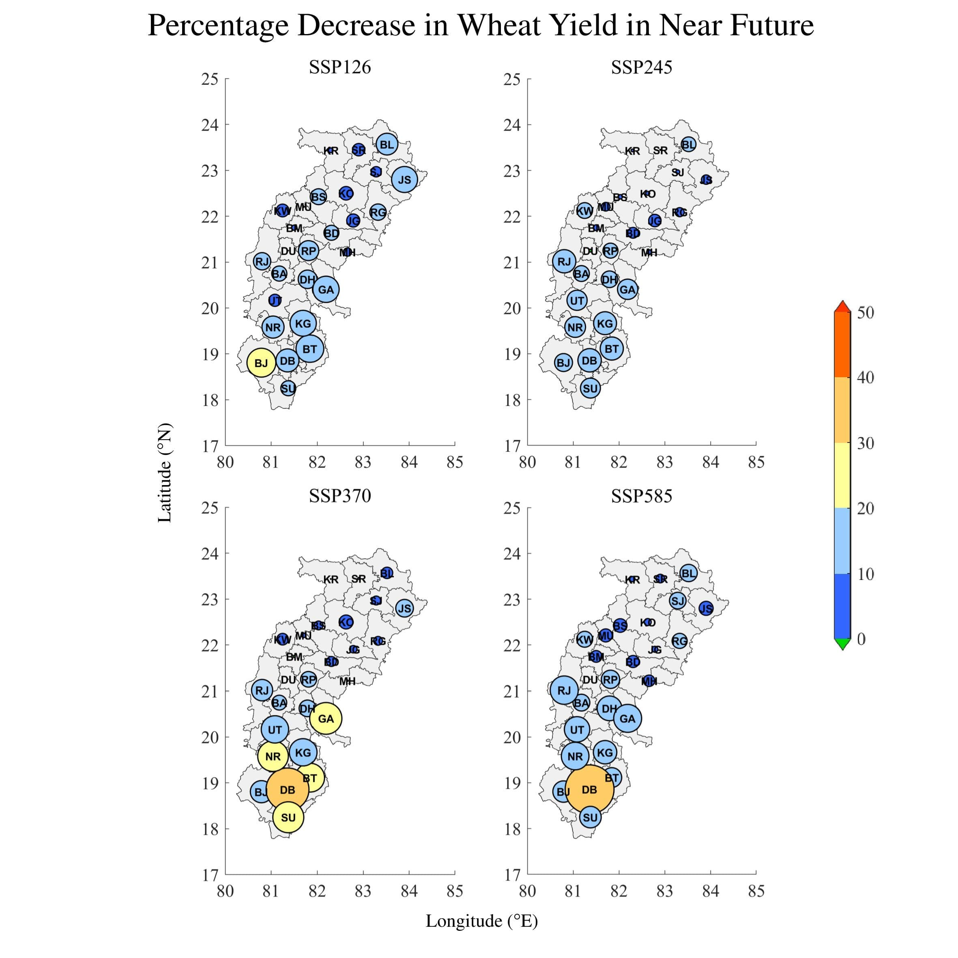
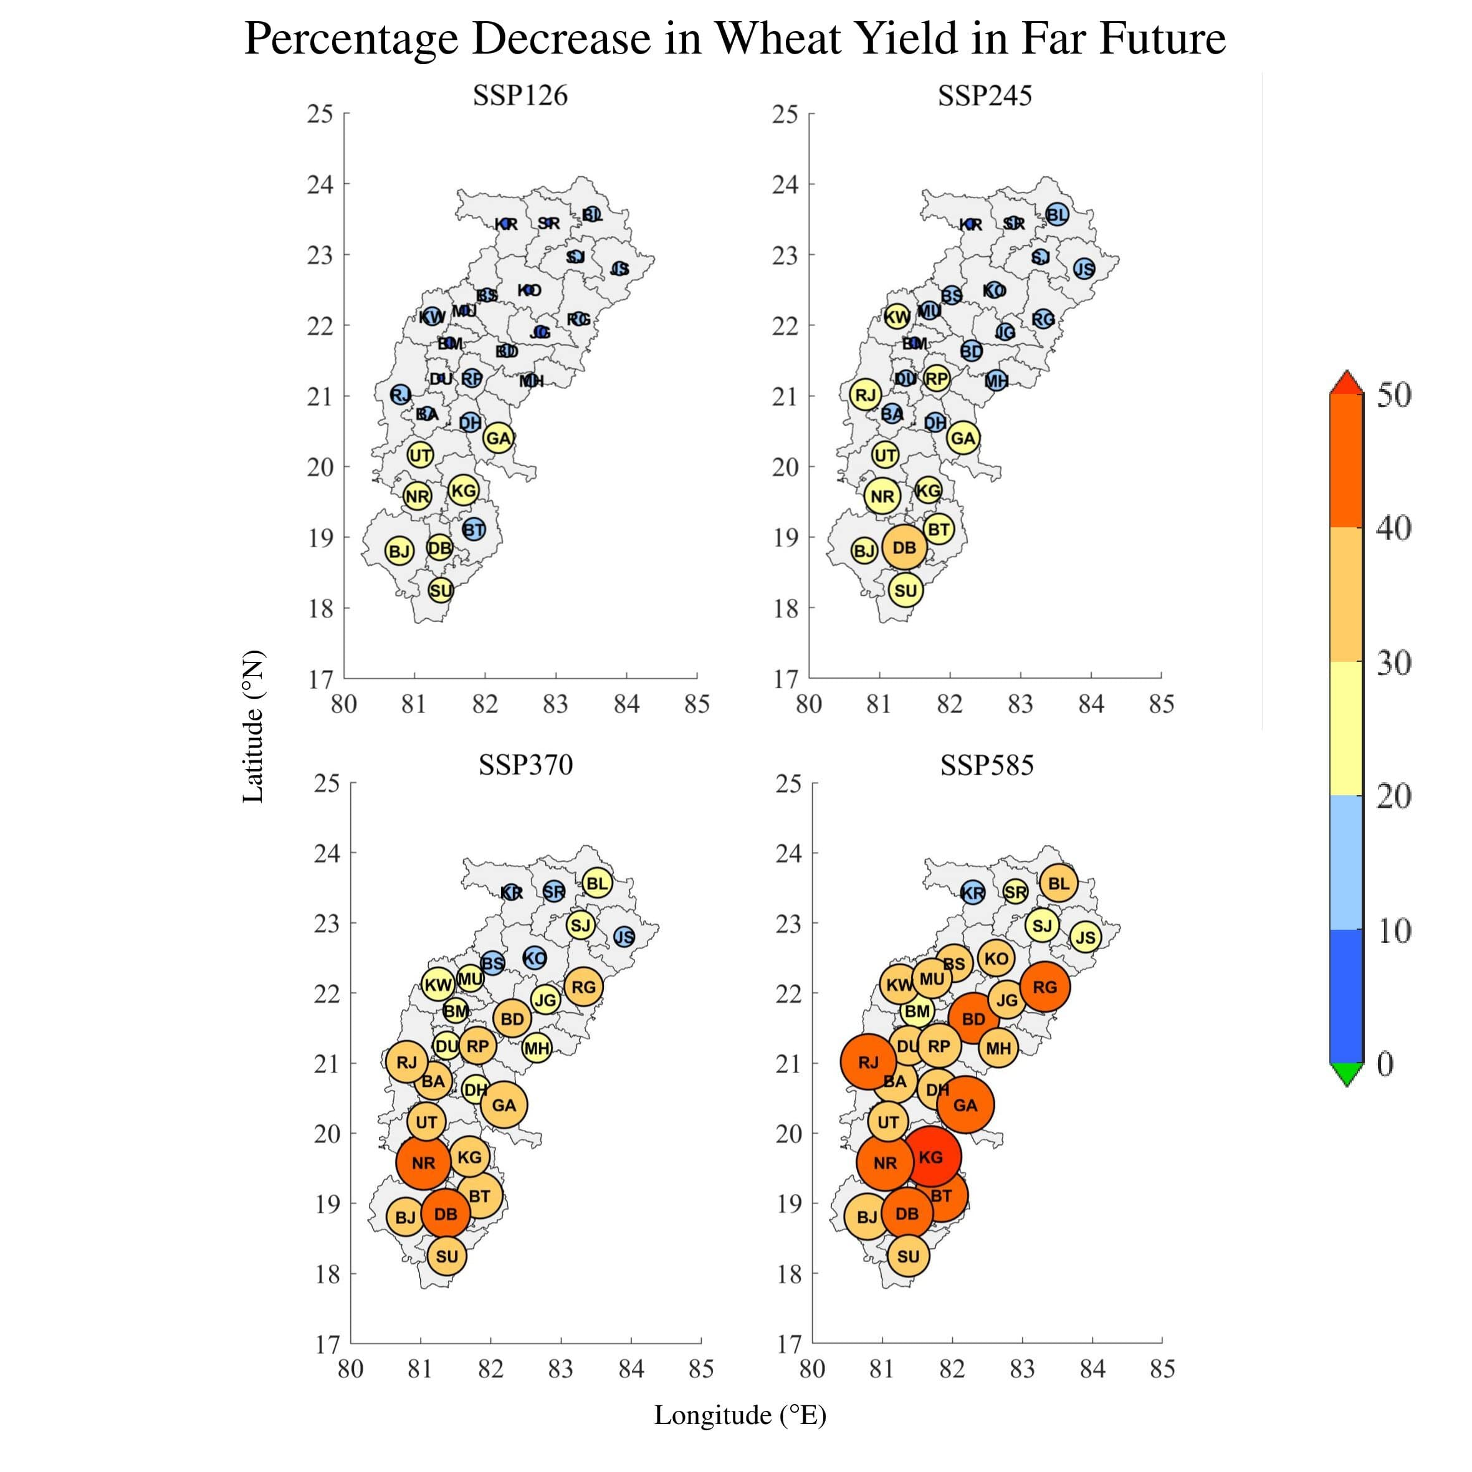
Impact on Wheat Yields During Near Future (2021-2060) and Far Future (2061-2100)

Slide 26
CONCLUSION
26
Following bias-correction, the maximum temperature is projected to increase by 2.52% to 10.79%, the minimum temperature by 9.25% to 28.63%, and precipitation by 11.87% to 22.86%.
The results suggest that the wheat yield is expected to decrease in future in all SSP scenarios compared to the historical period.
In the near future, yield is expected to decrease by 11.12%, 8.92%, 11.68% and 12.70% under SSP126, SSP245, SSP370 and SSP585, respectively.
Yield are expected to further decrease in the far future by 14.10%, 18.81%, 27.97% and 35.33% under SSP126, SSP245, SSP370 and SSP585, respectively.
In both the periods the most decrease is expected in the Bastar plateau, followed by Chhattisgarh plains and Northern hills.

Slide 27
27
FUTURE SCOPE
A similar idea can be extended for a bigger region to study weather these changes are still prominent on the same scale.
A multi-model ensemble of CMIP6 models can be used.

Slide 28
Thank you Your questions are welcome!

